Slide 1
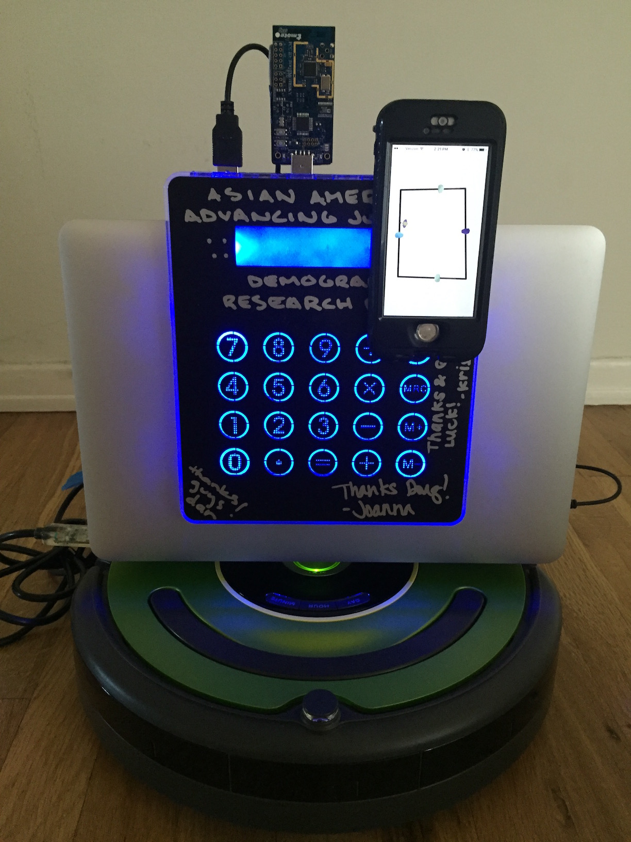
Roomba + 2D Mapping
EE 579 Final Project Presentation
Aashiq Ahmed, Shuai Chen, Meha Deora, Douglas Hu
Notes:
Shuai’s Comment on this Presentation:
Title
-Define Problem(Why we have to do this project)
-Measure Problem(What is current status, unsolved problems?)
-Analyze Problem(What approach we are planning to do?)
-Implementation(How we did it? What have we achieved?)
-Future work/Unsolved Challenges(What we failed!)

Slide 2
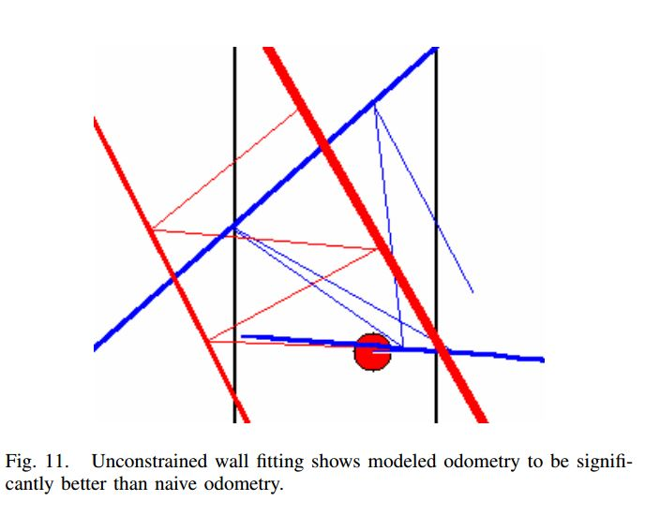
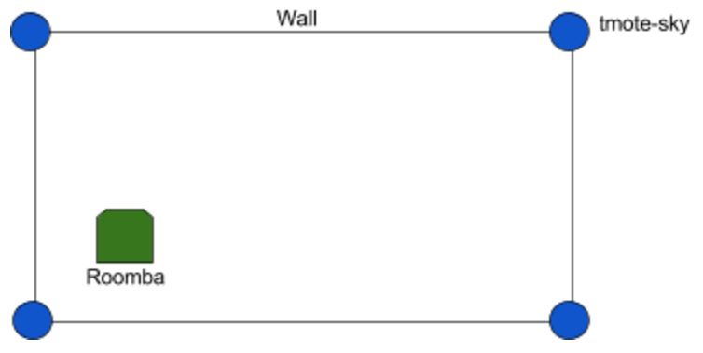
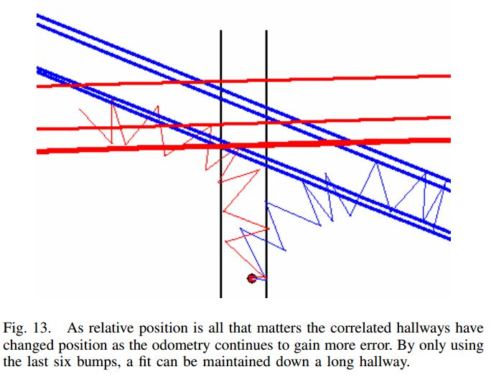
Motivation
Current solutions on Presence Detection Technologies:
Many require cameras to do mapping
Using Kinect (very accurate)
Many other solutions are very erroneous
We want to implement 2D mapping based on what we have:
Tmotes, Roomba iCreate2 Robot (a Vacuum Cleaner that doesn’t work!), later Estimotes
But... Our real motivation...
Ground breaking technology!
Priority: High!
Cool Factor: High!
Complexity: High!
Device Integration: High!
Notes:
Explain why we need to do this project? What is the significant of it?
1 approach to talk about our motivation: current technology sucks! Has to have cameras, some are inaccurate
Show what are we trying to achieve: Wasn’t that cool if we can Map the room without using cameras! (Blind mapping!)
Note: Existing RF only localization implementation: Fingerprinting(Early 1990’s MIT), Maximum Likelihood Estimation(Early 2000’s Michigan), Sequence-based Localization(Mid 2000’s USC), Ultra Wide Band-based localization(10cm-scale accuracy)

Slide 3
Analyzing the Project
Tmotes Calibration
Use simplified path-loss model:
RSSI(dBm) = -10nlog(d) + A
Find n and A parameters for Tmotes
Triangulation (Locate the Roomba)
Usually Triangulation need three reference points
We can do it by using two points only
Do it 6 times and calculate the average
Controlling Roomba
Use serial I/O on Roomba to run our code
& Drilling holes!
Real-time Visualization
Process real-time location using MQTT
Print trace
Notes:
This slide shows our initial approach on the Project
We need to mention what/how/why we changed in later slides
1. Animation for RSSI to distance
2. animation for Triangulation

Slide 4
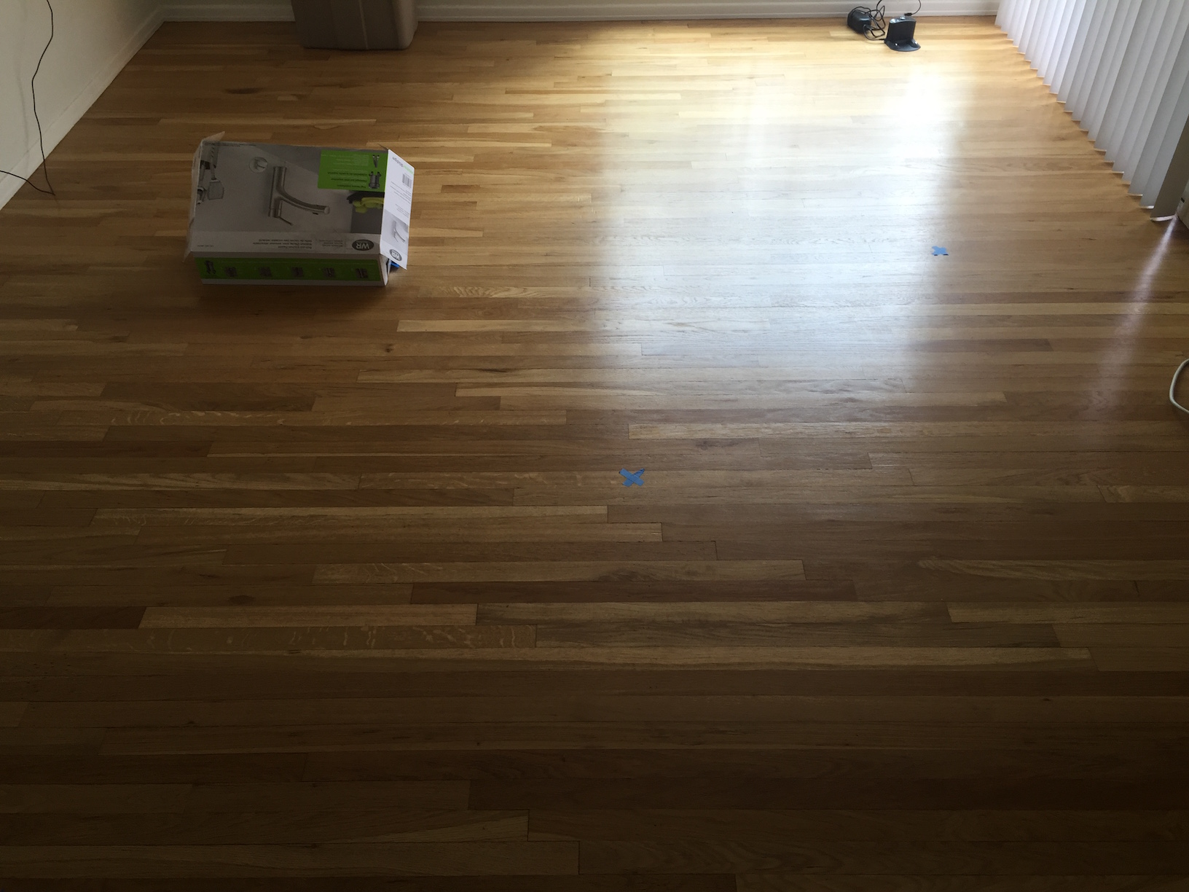
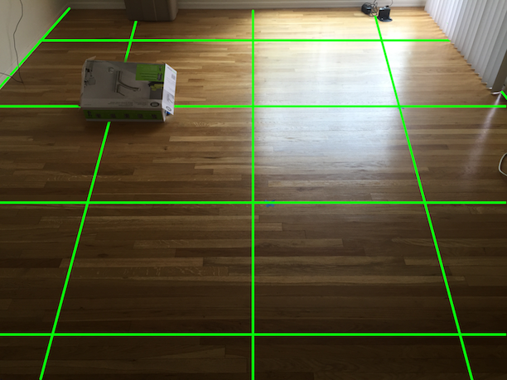
Approach
Discretized map
Mapping algorithm
Depth-First-Search
Breadth-First-Search
Indoor localization
Roomba internal odometry
Tmote triangularization
Estimote Indoor Location SDK
Visualization
Python turtle graphics
Plotly graphics
Notes:
Explain our approach
We might say Tmote and Estimote did not met our expectation?
In order to guarantee our customer satisfaction, we used fingerprinting???

Slide 5
Video Demo

Slide 6
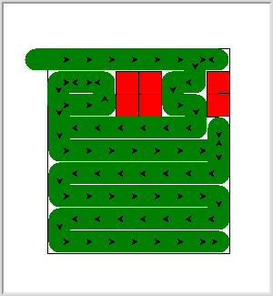
Real Time Mapping

Slide 7
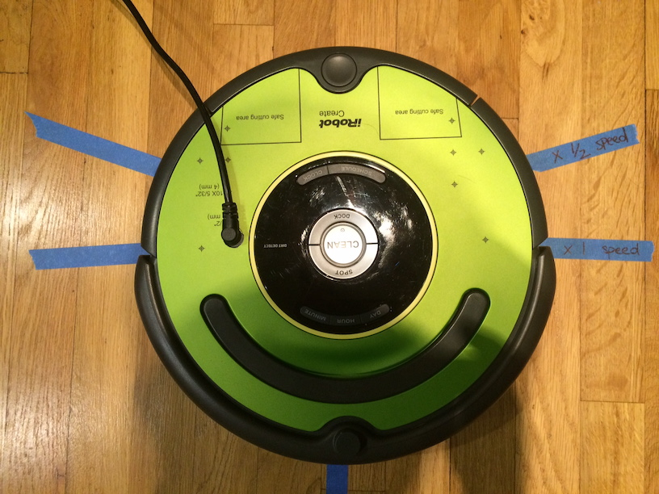
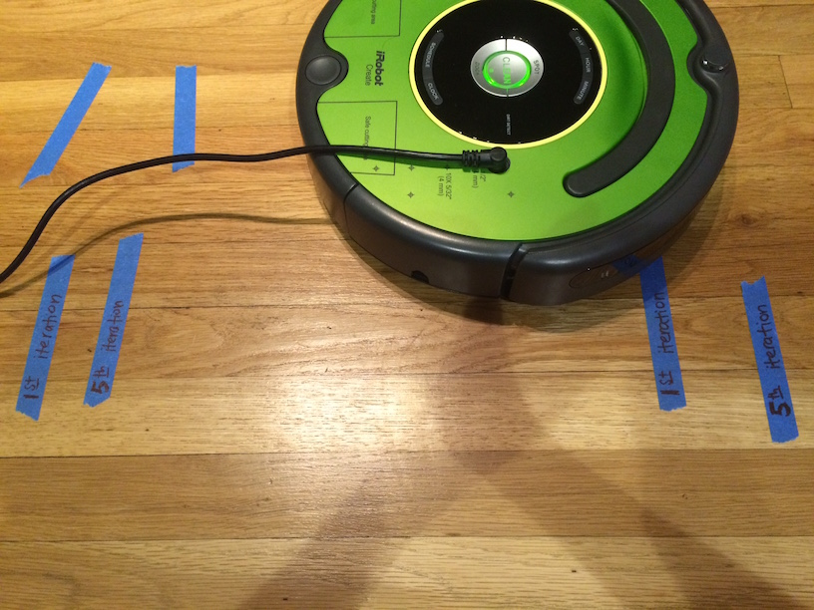
Hardware limitations
Roomba
rotation angle
forward drift
Notes:
We have to adjust the rotation based on ground surface?
Not exactly 90 degrees

Slide 8
Roomba Obstacle Discovery Algorithms
Three main Algorithms:
-DFS
-BFS
-Maze Wall Follower(left-hand rule or the right-hand rule):
-Used for Mazes which contain no loops
-Additional complexity due to random shapes of obstacles
-No access to Roomba Wall Follow Opcodes
-DFS/BFS required in addition to keep track of visited locations
Notes:
Aashiq
Right hand rule complexities due to random shape of obstacles, no access to wall follow opcodes in create2
And we would have to use DFS along with it any way to keep track of visited grids...

Slide 9
DFS/BFS Design Decisions
DFS | BFS
Tests all possibilities in one path until it needs to backtrack | Visit all nearest neighbors and then their neighbours
DFS goes to bottom of a subtree, then backtracks | BFS finds shortest path to destination
Both run till no unvisited location left
STACK Data Structure to keep track of next location to visit | QUEUE Data Structure to keep track of next location to visit
Notes:
Aashiq
Right hand rule complexities due to random shape of obstacles, no access to wall follow opcodes in create2
And we would have to use DFS along with it any way to keep track of visited grids...

Slide 10
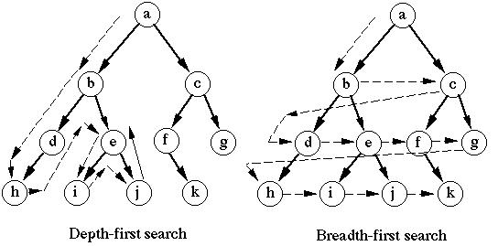
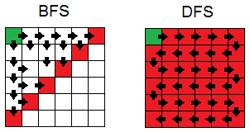
DFS/BFS Design Decisions
Notes:
Aashiq
Right hand rule complexities due to random shape of obstacles, no access to wall follow opcodes in create2
And we would have to use DFS along with it any way to keep track of visited grids...

Slide 11
Roomba Path Visualization over time
Simulation: DFS for the Roomba movement and BFS(in simulation) when backtracking

Slide 12
Roomba Mapping Integration with Tmotes and Estimotes
When Integrating, to get map obtained with the motes,
We record every location the roomba rotates,
Through this we can
-Recreate Path taken using locations as line starting and ending points
-And visualize each of the obstacles as closed circles
Notes:
Aashiq
Right hand rule complexities due to random shape of obstacles, no access to wall follow opcodes in create2
And we would have to use DFS along with it any way to keep track of visited grids...

Slide 13
Indoor Localization Design Decisions
Tmotes | Beacons | Pozyx(UWB)
IEEE802.15.4 | IEEE802.15.4, | IEEE802.15.3
Light,Temperature,Humidity sensor | Accelerometer sensor | Pressure sensor
2.4GHz | 2.4GHz | 3.5GHz
Cheap | Cheap | Expensive
NA | 0.5 -1m | 10 cm
40m range | 40m range | 200m range
Notes:
Meha (Shuai: this is the same with slide 8?)

Slide 14
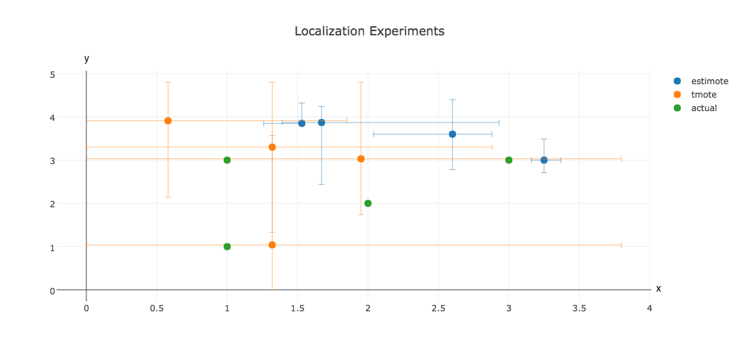
Hardware limitations
 | Tmotes | without rotating... |  |  | Estimotes
actual location | estimated loc | error | x range | y range | estimated loc | error | x range | y range
(1,1) | (1.32, 1.04) | 0.1 | (0.0, 3.8) | (0.0, 3.57) | (3.25, 3.00) | 9.06 | (3.16, 3.37) | (2.71, 3.49)
(2,2) | (1.32, 3.30) | 2.2 | (0, 2.88) | (1.33, 4.8) | (1.67, 3.87) | 3.61 | (1.39, 2.93) | (2.44, 4.24)
(3,3) | (0.58, 3.91) | 6.68 | (0.0, 1.85) | (2.14, 4.8) | (2.60, 3.60) | 0.52 | (2.04, 2.88) | (2.78, 4.40)
(1,3) | (1.95, 3.03) | 0.91 | (0.0, 3.8) | (1.74, 4.8) | (1.53, 3.85) | 1.01 | (1.26, 1.54) | (3.84, 4.32)
Notes:
Tmotes more accurate, but less precise
We calibrated each Tmotes individually because n and A parameters are totally different
Estimotes more precise, but less accurate

Slide 15
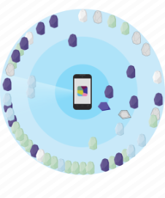

Slide 16
Deliverables
5 Python Modules:
Roomba Drive & Sensors API
Tmote Trilateration Library
Paho MQTT Subscriber
DFS/BFS Mapping Script
Turtle Visualization/ Simulation
Easy to use:
“import roomba”
“import trilateration”
“import mqtt-paho-subscriber”
Notes:
Do we need this slide? Maybe as a conclusion? (Shuai)

Slide 17
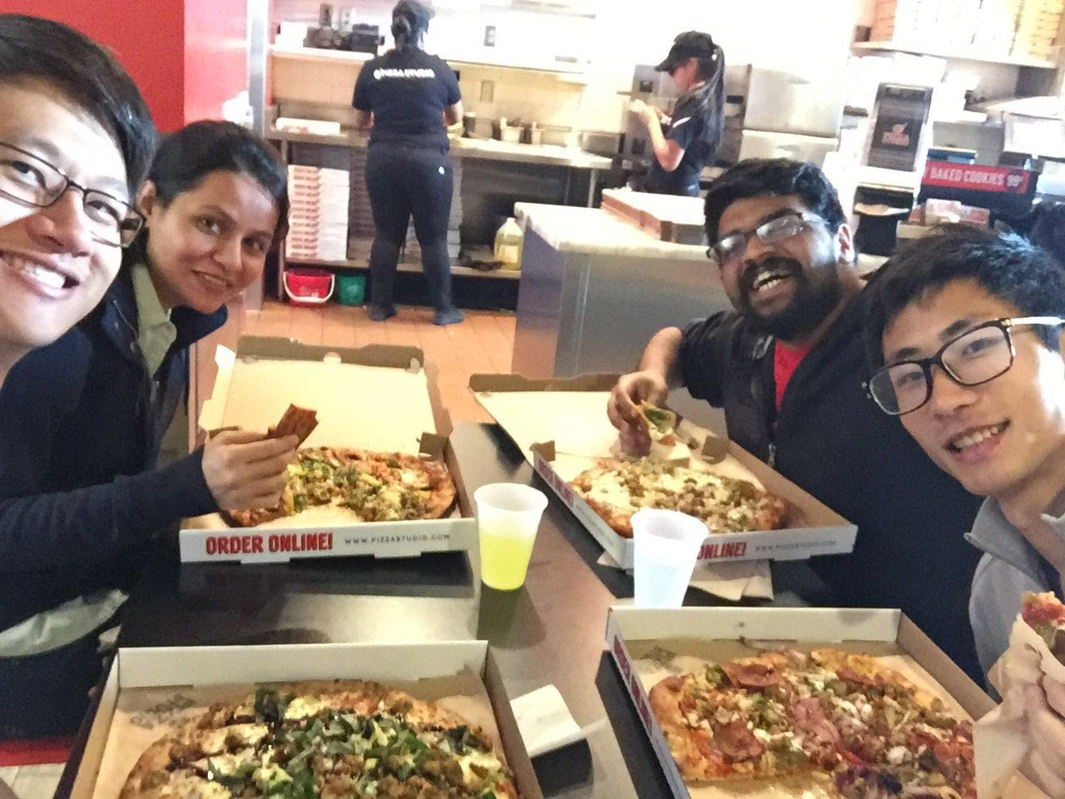
Thank You!
Questions?
Notes:
Questions slide should have a useful summarizing diagram

Slide 18
Further Engineering Challenges
mqtt slow on usc network
roomba drifting
Tried to fix with different speed wheels, but the wheel speeds are discretized - hard to be corrected exactly - granularity 20
estimotes don't work due to glass interference in rth
tmotes dont work on portable batteries
Rug better than tile floor better than wooden floor
worse performance of roomba when it has to stop...
when speed ..roomba performs bad
Notes:
Possible future work to improve?

