Slide 1
Visual Symphony
Wireless and Mobile Networks Design and Laboratory
Qing-qing Zheng
Yuan Ma

Slide 2
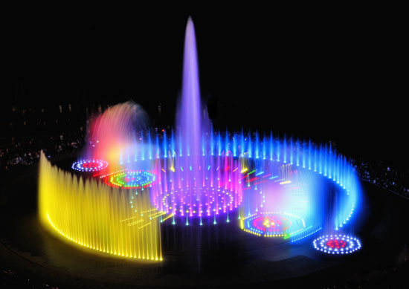
Introduction
The interaction of visual art and computer science
Apply the characteristics of music to the characteristics of filament
Notes:
Visual symphony is a kind of visual art that we can enjoy the music and watch the change of the music flow in some sort of format at the same time. We think this project would be a great chance for us to explore the interaction of science and art, so we abstract the characteristics of the music and apply those changes to the brightness and color of the smart bulbs

Slide 3
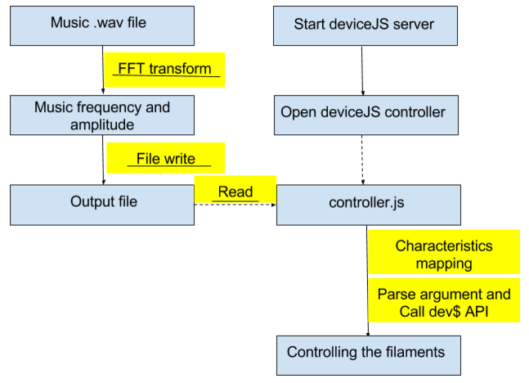
Modules Architecture

Slide 4
Principle
Frequency and amplitude detection and extraction of music
Filament changing color and brightness based on the frequency and amplitude
Relations:
frequency-->color
amplitude-->brightness

Slide 5
Frequency Detection Platform
java-->python
Java: no fft algorithm
Python: pyaudio(play music), wave(read music file), numpy(fft method)
Music stored as bytes. Take them out and convert them to float type and also do fft function call, from that output choose the biggest one as the frequency of this chunk. abs(fft()) is the amplitude. Print out the frequency and amplitude to data.txt file

Slide 6
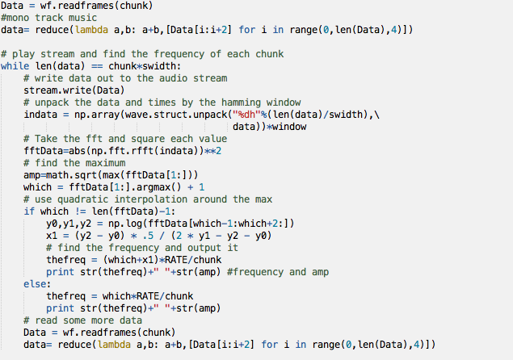
Code Snippet
chunk:2048

Slide 7
Problems We Faced in Signal Processing
1.how to detect frequency(fft)
2.python packages installation(No space left)
3.play music(open file error,EOFError)
4.adapt the frequency and amplitude in the matched range

Slide 8
DeviceJS (filament)
1.From data.txt get frequency and amplitude
2.set variable freq and amp to those value
3.assign freq to color, amp to brightness, both between 0.0-1.0
4.selectByID()-->change color and brightness

Slide 9
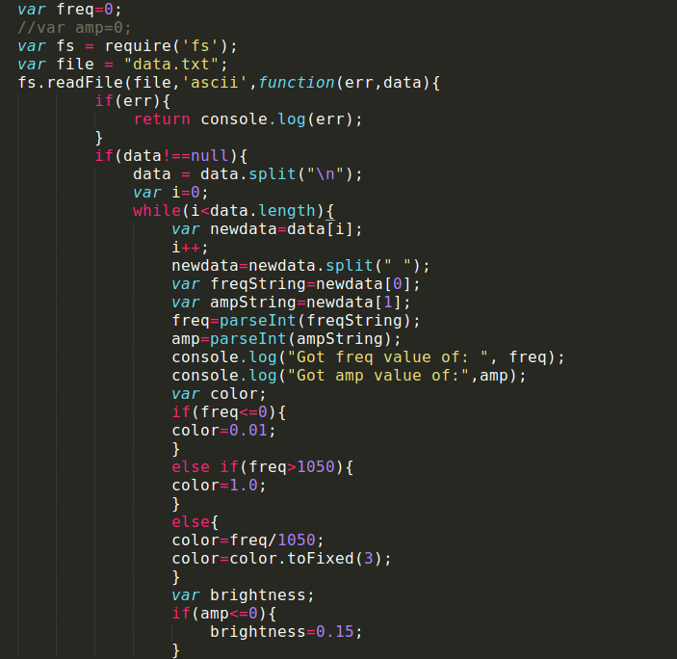
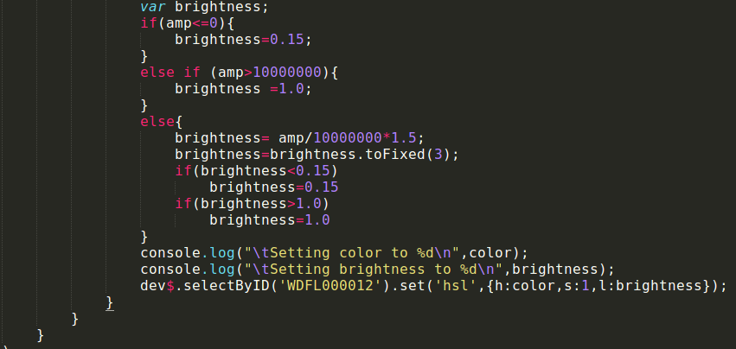
Code Snippet

Slide 10
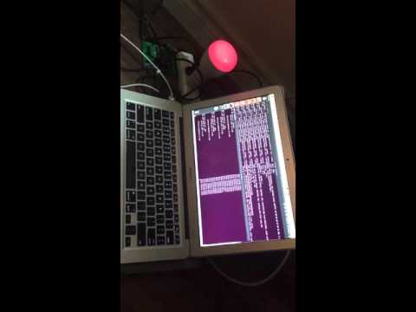
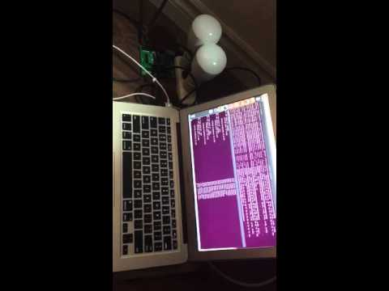
Experiment Demo 1

Slide 11
Problem We Faced in Network
1. Asynchronous read and write leads to misbehavior of Javascript function
2. Network delay results in asynchronization, doesn’t need sleep() here
3. Unstable network environment may results in packet drop, the filament has no reaction
4. When having two filaments connected, the 6LoWPAN buffer can more easily to get overflow and timeout

Slide 12
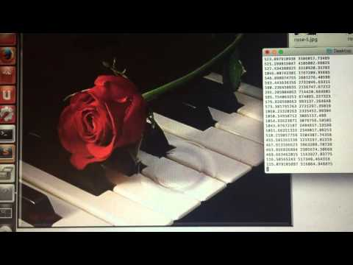
Experiment Demo 2
Recorder.py:
Get streaming music sound
Visualizer.py:
Call Recorder.py and map each frequency range to each picture
Python library:
Pygame
Pyaudio

Slide 13
Future Work
Running the detection and extraction part on cloud?
Using an array of filaments?
Enabling streaming reading?
Decreasing the delay between the controller and the device
Increasing network buffer
Notes:
short latency and concurrency
Streaming reading data and sending data

Slide 14
Software and Hardware Support
Language used:
Python, Javascript
Software support:
Python 2.7.3, Node v4.3.1, gcc 4.8.1, g++ 4.8.1
Operating System support:
Ubuntu 12.04 or higher
Platform support:
deviceJS + modules
Hardware support:
WigWag devices(filament), USB cable A-Male to B-Male

