Slide 1
P2P file sharing system with a central server
Boyu Chen
Yulin Xia
Haoyu Xu
Viterbi School of Engineering
University of Southern California
2012.5

Slide 2
Outline
Introduction
System architecture
Connection and File transfer Process
Conclusion

Slide 3
Introduction
Mobile network
Wi-Fi
Wi-Fi Direct
Wi-Fi display
Notes:
The technology has evolved from mobile network to wifi to wifi direct and wi-fi display between PC in near future.

Slide 4
Connect with possibilities
One to one mode
One to many mode
many to many mode ?
Notes:
Good things about Wi-fi direct is network connection without exterior network, just two phones with wifi direct module. It provide three modes connnection: group owner to client, group owner to many clients, and group owner to wireless. What about client to client? Wi-fi direct does not provide internet connect between clients. We are exploring this feature.

Slide 5
A whole new idea !
Wi-Fi Direct
P2P
Android Wifi-P2P app
Notes:
So we come up with a new idea. With wifi-direct and p2p. A new android APP.

Slide 6
System architecture
Main Activity
Network Manager
Join/Exit Network Group
Peer Register/ Unregister
Browse Peer Activity
Peer Manager
Peer Info Details
File Download Activity
File List
File Fragments Receiver
Peer List
Downloading config
File Request Message
File Transfer Protocol
Notes:
Most of the things we implement is file transfer protocol

Slide 7
Original proposal
Use PC as central server
Client directly connect with client
Modified proposal
Use group owner as server
Routed through group owner
Compare different network topology
Implement new feature in Wi-Fi direct architecture
Notes:
There are several difference between our original proposal and modified proposal
Due to constrain or connection mode of WiFi-direct device, we change from XXX to XXX
Our work focus move from compare different network topology to implement new feature in wifi-direct architecture

Slide 8
Group owner and client
Group owner
(perform as AP)
client
client
client
Obtain IP and file request
Notes:
Group owner perfrom as AP to routing and relaying information (optional, deletable)

Slide 9
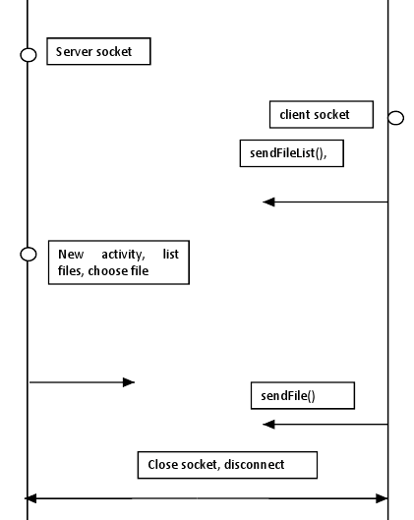
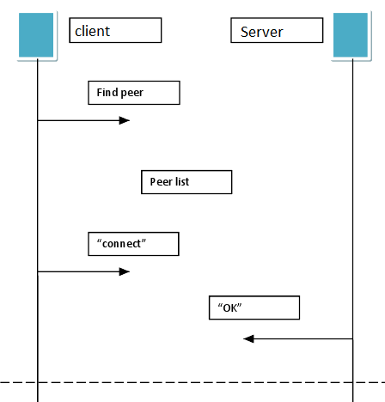
System Architecture
client
Fidning
peers

Slide 10
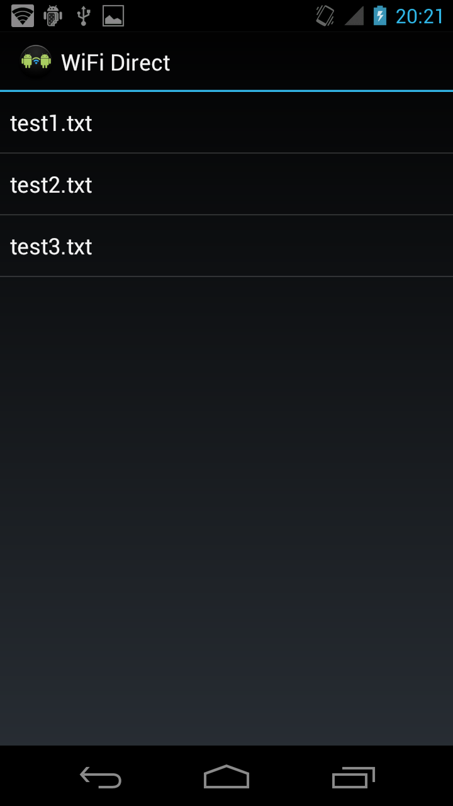
System Architecture
client
Find peer
connect
server
File list
OK

Slide 11
System Architecture

Slide 12
System Architecture

Slide 13
Algorithm
Small file size, high transfer speed for 2~3MB per second
No need to divide file into chunk
Our algorithm focus on seeking the idle client so that the client can request service from another one
Send request message ;
If (file search match && the client is idle){
{
if (one client found)
download;
else
pick a client with best Wi-Fi direct connection quality;
}
else wait for a timeout to send the request again ;
}

Slide 14
Problem with multiple devices
Constrain:
Connection in a group owner & client way, do not support client and client direct communication
Client is the initiator of the file transfer
Only group owner support the wireless connection
Possible solution:
Pure peer to peer network (negative)
Use PC as central server (negative)
Use group owner as the central server and relay, implement message transfer between server and client to enable client to client communication.
Create socket to enable the direct communication among clients
Notes:
There are many constrains in the wifi-direct feature, because it’s a new technology. One of them is clients cannot connects with client
we come up with an idea to use group owner as information exchanger and relay, which we have done in our implementation.
Or we write some socket connect part between clients to enable the connection, but this is just hypothesis.

Slide 15
Conclusion
Develop application in a point to point two way transmission base on the current Wi-Fi direct architecture
Implement in the system of multi-client communication in the Wi-Fi direct

Slide 16
Questions?

